Slide 1

Airbnb Investment
Sarah AlKhudair
Nahla AlArifi

Slide 2
Table of Contents
Airbnb Activity.
The Question.
The Analysis.
Our Recommendation.
Data Cleaning.

Slide 3
Airbnb Activity
61% of the properties were apartments, 33% were houses.
The top performing properties had two factors: Catchy listing name, and many special amenities.

Slide 4
Question:
Should you invest in an Airbnb hotel in Washington, D.C.? If so, where?

Slide 5
In terms of:
Neighborhood popularity.
Neighborhood sentiment.

Slide 6
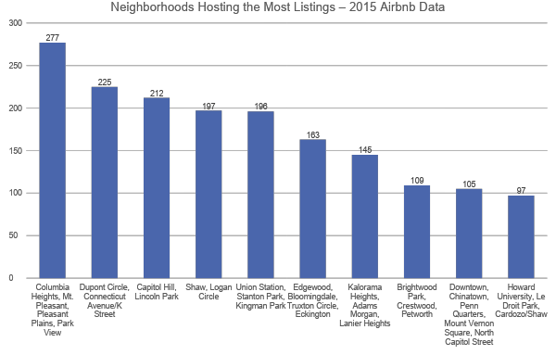
Most Tested Markets

Slide 7
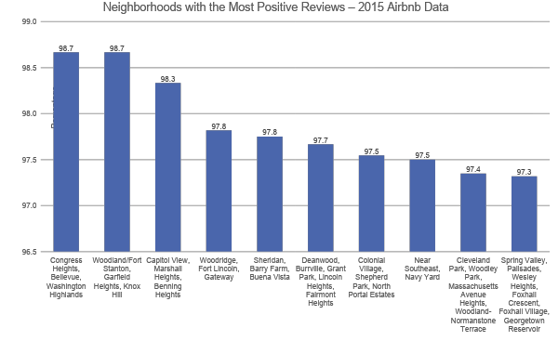
Most Positive Reviews

Slide 8
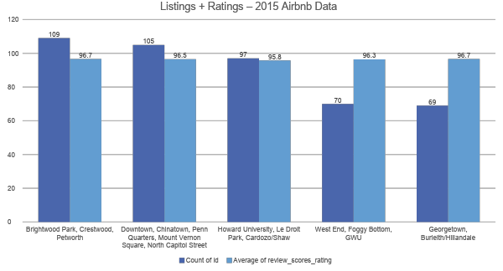
Where to invest?

Slide 9
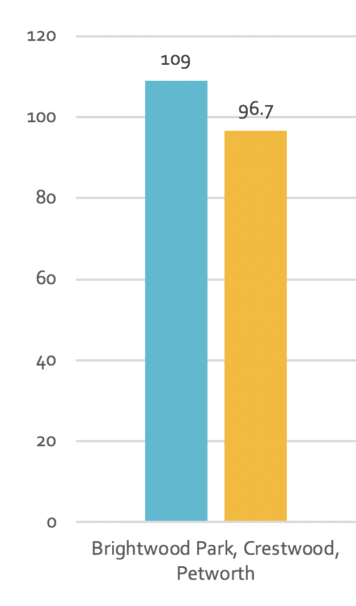
What We Recommend:
Why?
Market is tested fairly.
High % of positive reviews.
Convenient # of listings.

Slide 10
Data Cleaning
Properties with zero reviews were excluded.
Unnecessary columns were deleted:
All URLs.
All scraping columns.
Latitudes and Longitudes.
All columns that describes the property in details.
Blanks were deleted whenever needed(incase of calculations).

Slide 11


Thank you.

